Slide 1







Smart Waste Collection And optimization
Presented by Team
Smart Analytics

Slide 2
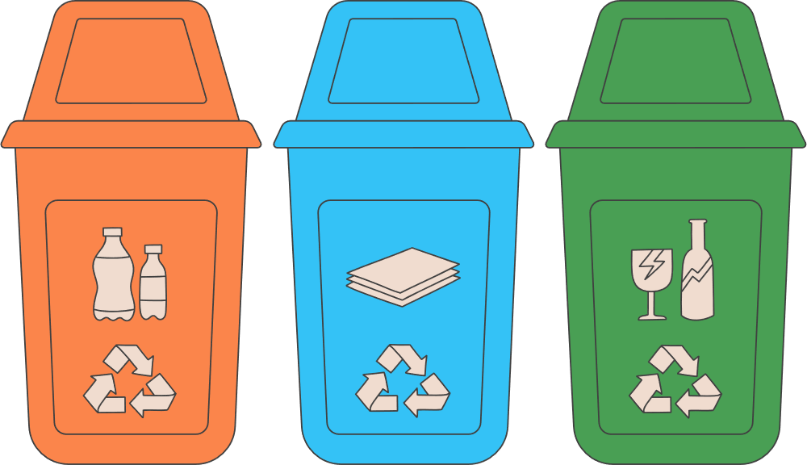
INTRODUCTION
Urban waste management is a major challenge in growing cities like Nagpur
Traditional systems use fixed routes, causing inefficiencies
Issues include overflowing bins, unnecessary trips, and high fuel usage
Lack of real-time monitoring limits effective decision-making
Smart system uses data, AI, and optimization techniques
Leverages historical data, IoT, and predictive analytics
Enables efficient route planning and proactive waste management
Aims to create a cleaner, smarter, and more sustainable city

Slide 3

OBJECTIVES
Optimize Collection Routes Design efficient routes for garbage trucks to reduce fuel consumption, time, and operational costs.
Predict Waste Levels Use historical data and AI models to forecast waste generation and prevent bin overflow.
Enable Real-Time Monitoring Provide visibility into bin status and collection activities for better coordination.
Improve Resource Utilization Ensure optimal use of trucks, manpower, and infrastructure.
Support Data-Driven Decisions Deliver actionable insights through dashboards and analytics.
Enhance Sustainability Reduce carbon footprint and contribute to smart city initiatives.

Slide 4

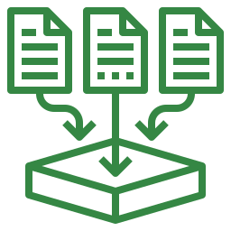



PROCESS
Data Collection Gather data from multiple sources:
Excel (bin fill levels)
Historical collection data
Weather and event data
Data Processing & Cleaning
Clean and organize raw data ,
Handle missing or inconsistent values ,
Prepare data for analysis
Analysis & Prediction
Use machine learning to predict waste levels
Identify patterns and trends
Forecast when bins will overflow
Route Optimization
Apply optimization algorithms
Generate the decision model
Minimize travel time and fuel usage
Visualization & Monitoring
Display insights on dashboards
Track bin status and routes in real time
Provide alerts for overflow or delays
Decision & Action
Authorities use insights to plan collections
Adjust routes dynamically
Improve overall waste management efficiency

Slide 5
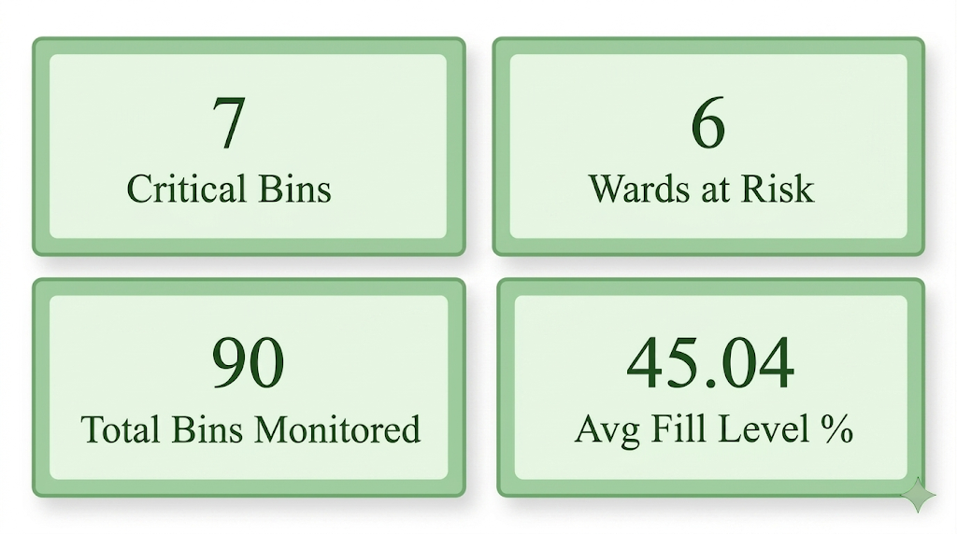
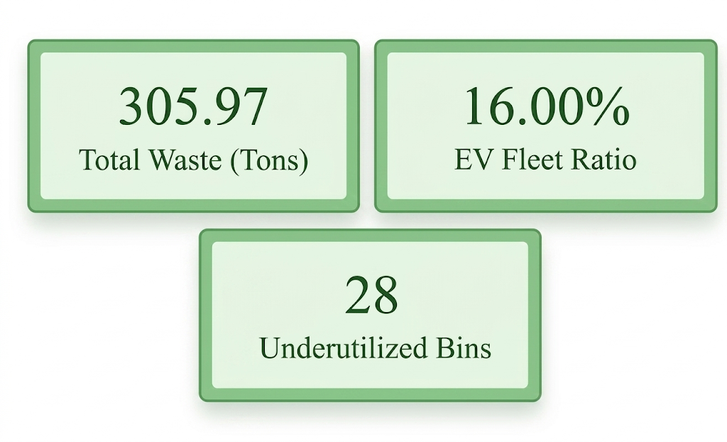
Quick Summary
05

Slide 6
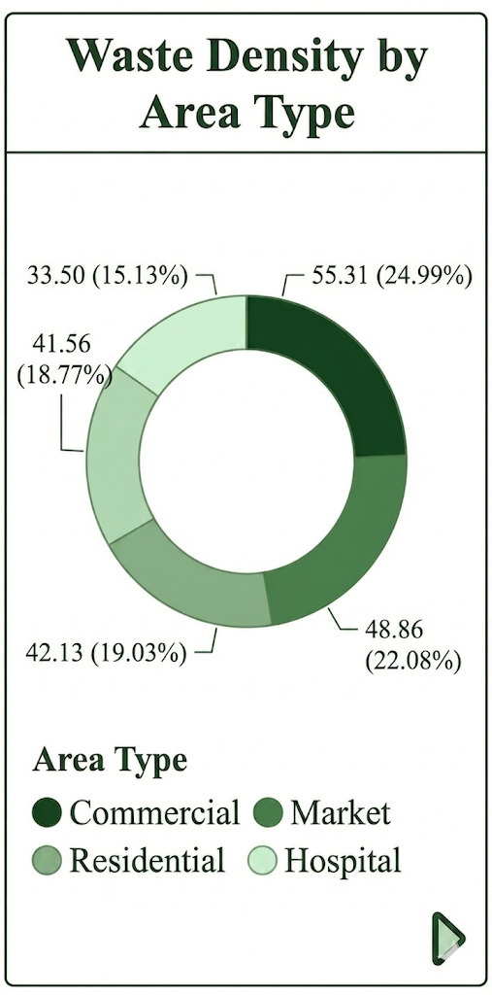
Support Data-Driven Decisions
Commercial (~25%) is highest → major waste hotspot
Market + Residential (~41%) → consistent bulk generators
Hospital (~15%) lowest → low volume but sensitive waste
Solution: Prioritize commercial zones with frequent pickups, apply route optimization for market/residential, and ensure separate, compliant collection for hospital waste
0
Industrial

Slide 7
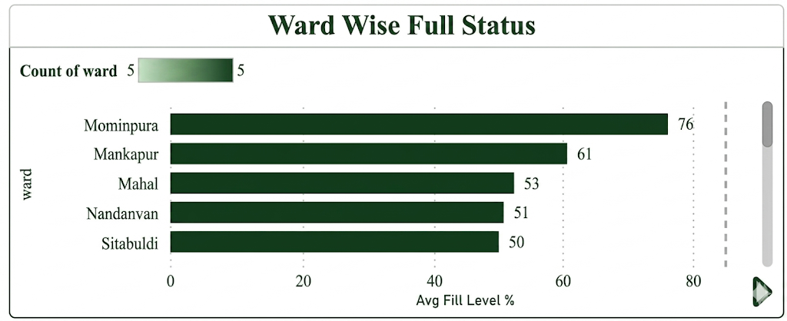
Ward wise Waste Levels
Mominpura (76%) is near critical capacity → needs immediate, high-frequency collection and overflow control
Mankapur (61%) is moderately high → increase pickups during peak days to prevent escalation
Other wards (~50–53%) are stable but rising → maintain regular schedules + monitor trends
Solution: Implement dynamic route optimization + smart bin alerts (IoT sensors) to prioritize high-fill wards and reduce overflow risk efficiently

Slide 8
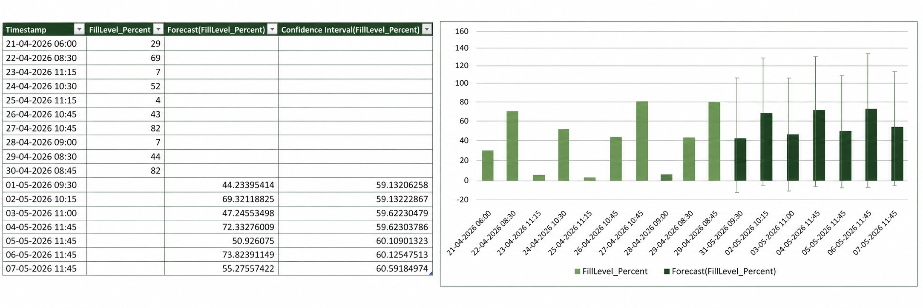
Prediction for Next 7 days

Slide 9
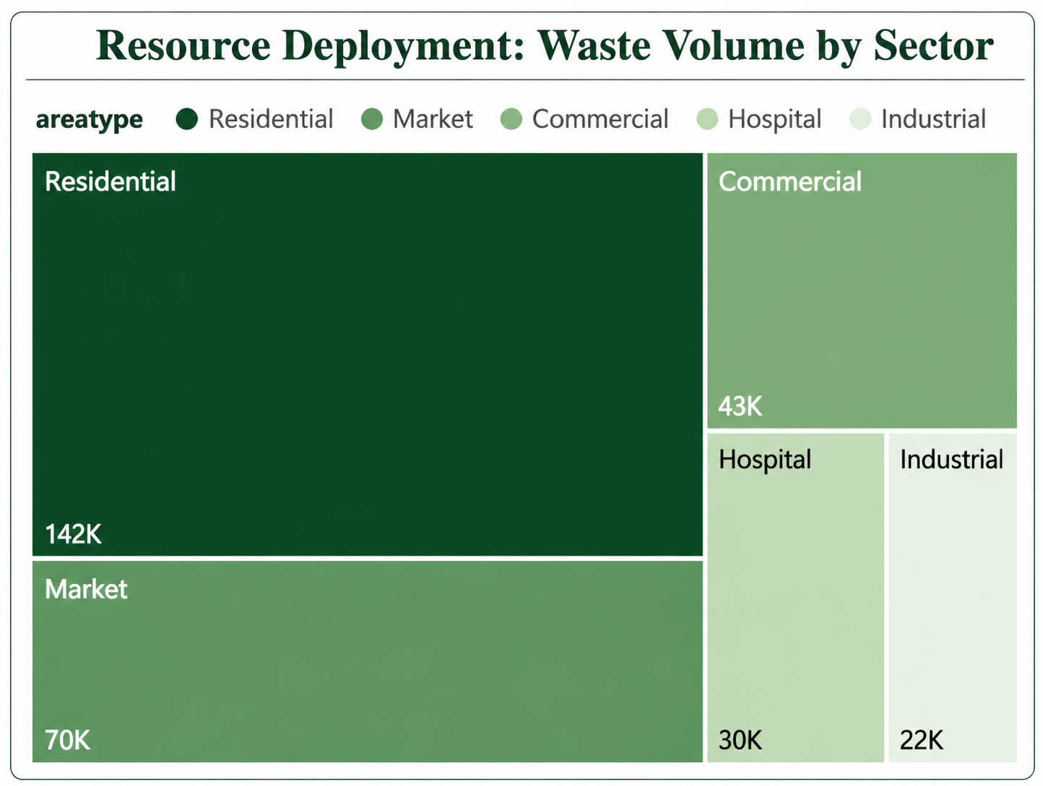
Improve Resource Utilization
Residential dominates (142K) → primary waste source, needs maximum resource allocation
Market (70K) + Commercial (43K) → significant contributors, require optimized routing
Hospital (30K) & Industrial (22K) → lower volume but higher handling complexity
Solution: Prioritize resource allocation by volume (more trucks for residential) + use AI-based route optimization + implement segregated collection for hospital/industrial waste to improve efficiency and safety
05

Slide 10
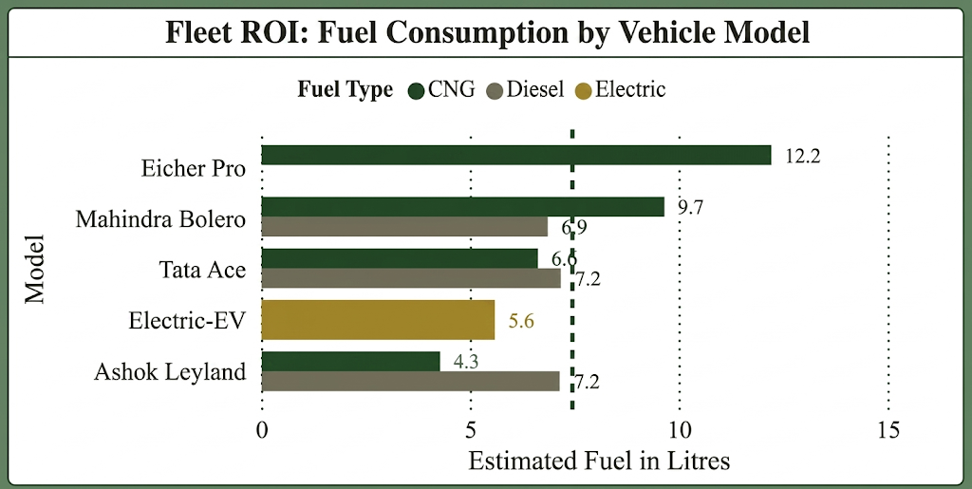
Optimize Collection Routes
Eicher Pro (12.2L) consumes the most fuel → highest operating cost, low efficiency
Mahindra Bolero (~9.7L) is moderate, while Tata Ace is relatively efficient (~6–7L)
Electric EV (~5.6) & CNG (4.3–6.6) → most cost-effective and fuel-efficient options
Solution: Shift fleet mix toward EV + CNG vehicles, reduce diesel dependency, and use route optimization + load balancing to minimize fuel consumption and improve ROI

Slide 11
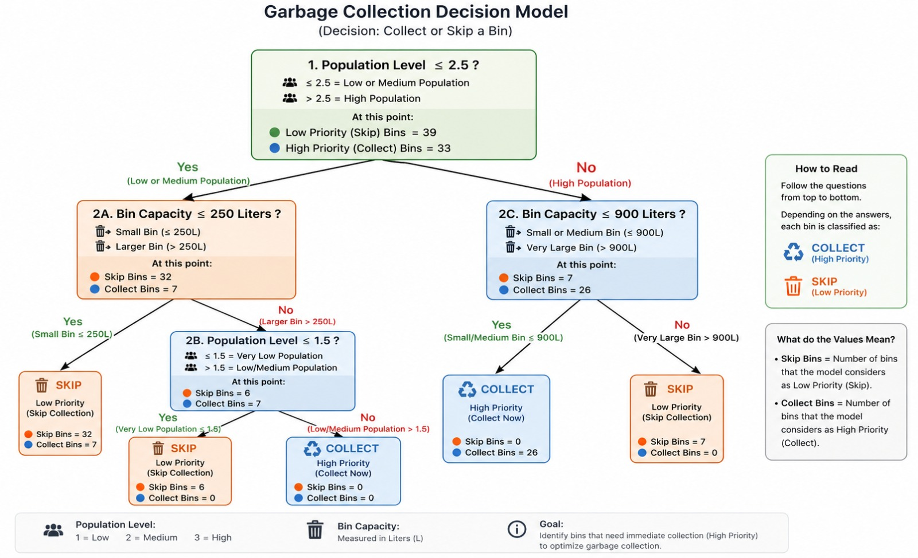
Garbage Collection
Decision
Model

Slide 12
RESULT
Route optimization reduced travel distance and fuel consumption,
Waste prediction models successfully identified high-fill areas,
Real-time monitoring improved visibility
Resource utilization improved
Dashboard insights enabled faster, data-driven decision-making
Overall, the system demonstrated cost savings, time efficiency, and better service quality

Slide 13
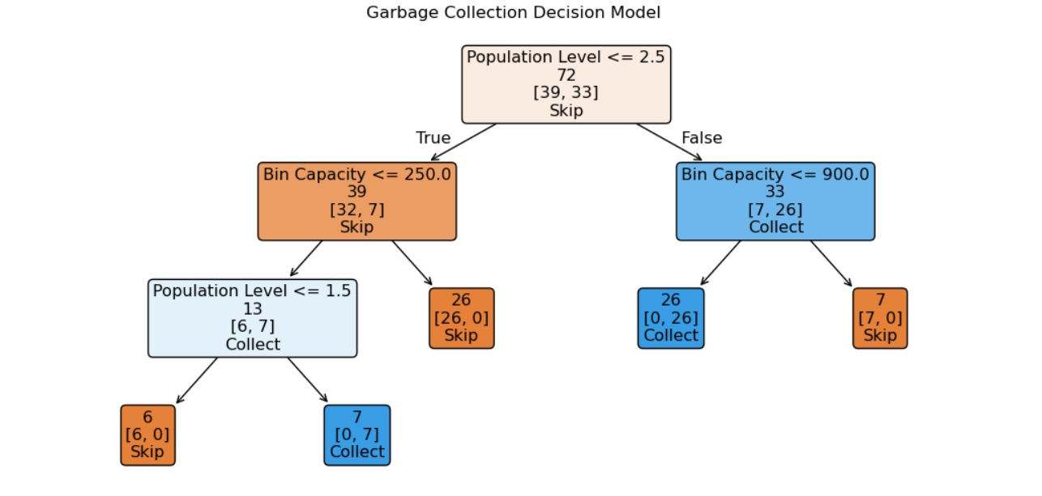
Overview of model
A decision tree classifies bins into Collect or Skip based on Population Level and Bin Capacity.
Root rule: Population ≤ 2.5 → mostly Skip, > 2.5 → mostly Collect.
Key splits:
Low population + small bins → Skip
Higher population or medium bins → Collect
Very large bins (>900L) → sometimes Skip (low urgency cases)

Slide 14
CONCLUSION
Integrating data analytics, machine learning, and optimization improves waste management
Replaces fixed routes with intelligent, data-driven planning
Reduces inefficiencies and improves operational performance
Contributes to a cleaner and more sustainable city
Supports smart city initiatives
Demonstrates the real-world impact of AI
08

Slide 15
THANK
YOU

